Slide 1
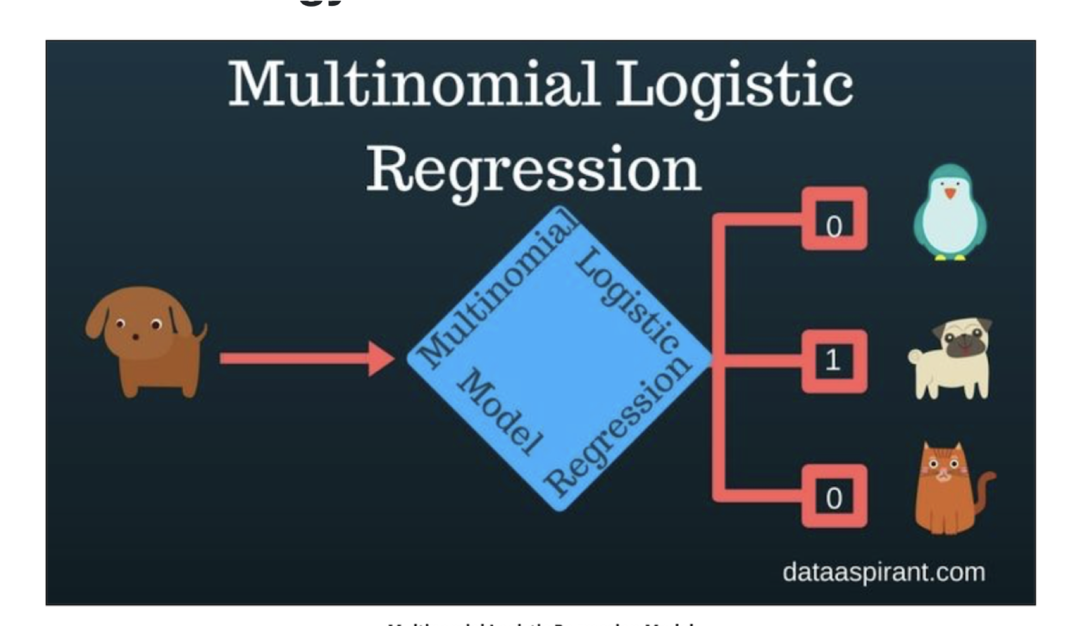

Slide 2
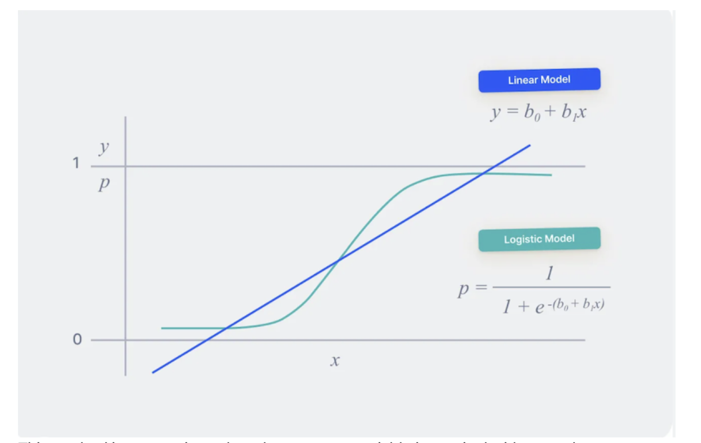
predicts the actual response value
predicts the probability of a category, then uses it to classify the response.

Slide 3
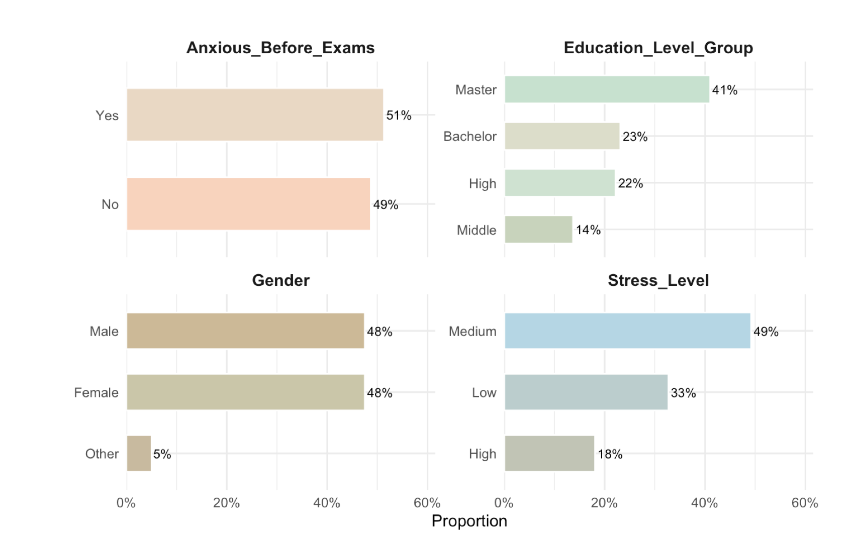
Summary of Students Proportion based on Categorical Variables
More than half of the students reported feeling anxious before exams
The majority were enrolled in Master’s programs with proportion at 41%
Gender distribution was balanced between males and females
In terms of stress, most students experienced a medium level

Slide 4
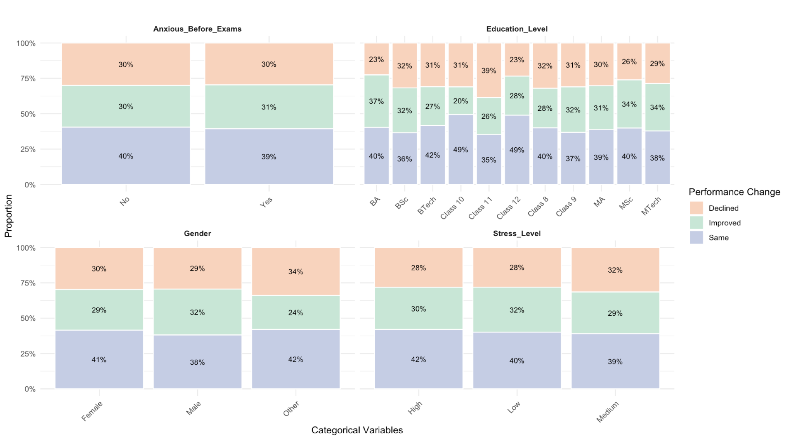
Performance Outcome Breakdown by Categorical Variables
There is no notable difference in performance change based on : Exam anxiety, Gender Stress level
The program performs well for Master’s and Bachelor of Arts students.
The program is less effective for high school and middle school students

Slide 5
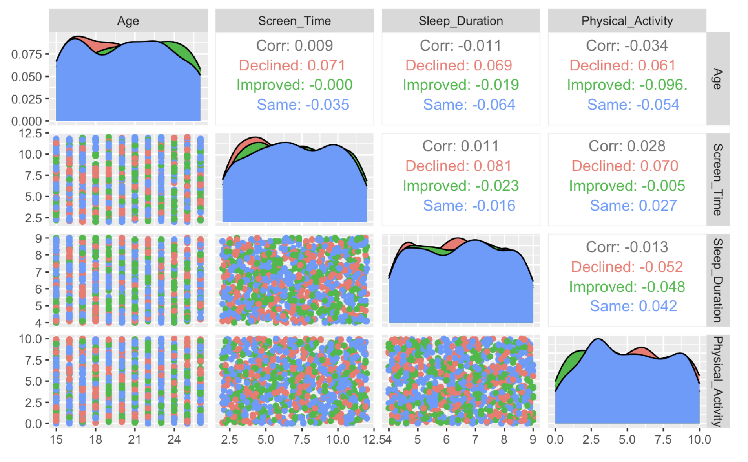
Performance Outcome Breakdown by Numerical Variables
No clear pattern was found linking continuous variables to academic performance change.
Correlation values across age, screen time, sleep duration, and physical activity were weak.
These results suggest no strong relationship between these variables and performance outcomes.

Slide 6
Result Modelling
Compared to students whose academic performance remained the same, Class 10 students showed a statistically significant difference (p = 0.02).
This suggests that educational level specifically being in Class 10 has a meaningful influence on academic performance changes.

